Slide 1
ENERGY

Slide 2

What is energy?
Energy is an essential ingredient of all activity on earth. Energy is somewhat abstract; we cannot see it or feel it, even though we have to pay for it.

Slide 3
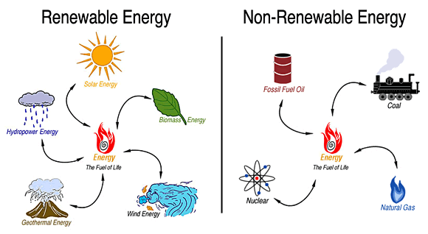
Energy Sources
The earth is a vast storehouse of energy. The fossil fuels beneath the surface, the wind and water on its surface, the plants growing upon it, the sunlight falling upon it, these are all sources of energy. All energy sources can be classified into two basic categories:

Slide 4
Non-renewable sources
Non-renewable sources: is energy from a natural resource, if used, will be depleted regardless of how it is managed. It can not be regenerated in a timescale relevant to human beings.
Resources that are consumed much faster than nature can create them are known as fossil fuels (because of their organic origin). Sources are coal, oil and natural gas.
Two common characteristics of fossil fuels
1. produced from decomposition of plant & animal remains & are forms of stored solar energy
2. it has taken millions of years for them to accumulate & form deposits which are mined for human use.

Slide 5
Renewable sources
A natural resource that is replaced naturally. Therefore, it never runs out.
Solar energy, wind, water and wave power, biomass etc. considered as renewable resources.
Most renewable sources of energy are also alternative sources of energy.
Alternative sources of energy usually refers to an energy source that can be used as a replacement for fossil fuels.

Slide 6
Concern regarding energy
Most of the global energy uses are dependent on non-renewable sources, especially fossil fuel which is supposed to end up soon.
Demand for energy is increasing day by day because of industrialization and population growth.
Most of the fossil fuel sources are highly polluting and produce Green House Gases.

Slide 7
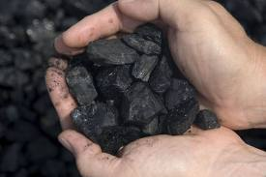
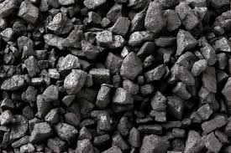
Coal
Fossilized plant material preserved by burial in sediments and compacted and condensed by geological forces.
Naturally available solid fossil fuel formed millions of years ago.
World coal deposit are ten times greater than conventional oil and gas resources combined.

Slide 8
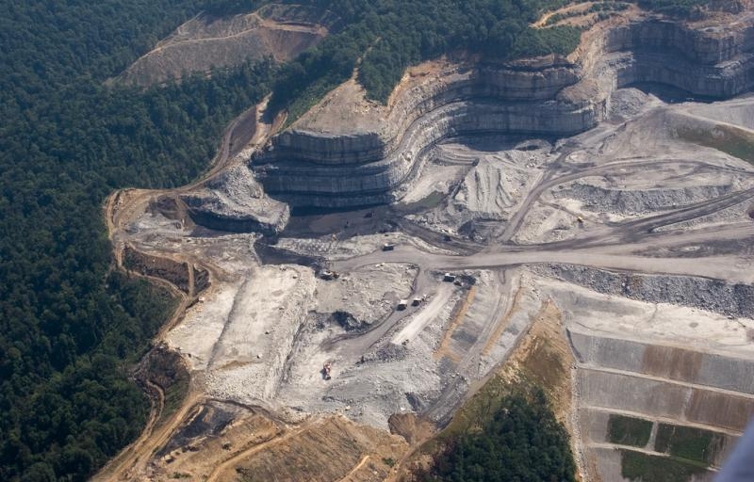
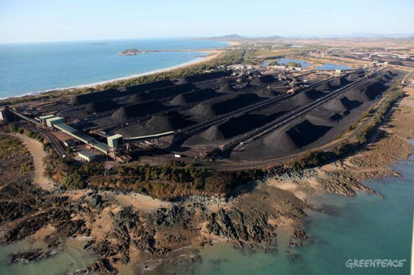
Problems with coal
- mining operations may involve large-scale deforestation
- requires large land areas
- mining may lead to different types of environmental problems
dust & noise pollution
disturbance to wildlife
underground mining involves working under risky condition, fire hazards killing the mine workers are not uncommon.

Slide 9
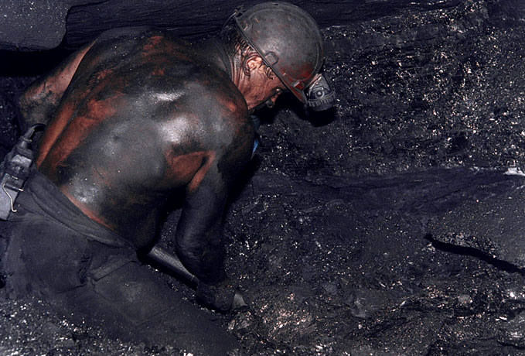
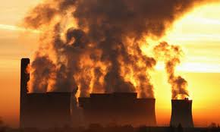
Respiratory diseases
- Land subsidence might occur
Air pollution
Burning releases radioactive and toxic metals into the atmosphere
Burning releases sulphur oxides and nitrogen oxides- acid rain
Burning release carbon dioxide–global warming

Slide 10
Natural gas
Is a hydrocarbon fuel, mixture of gaseous hydrocarbons with Methane (CH₄) as principal gas
found underground in close association with crude petroleum reserves
has been formed from marine fossil deposits of plants & animals buried millions of years ago & subjected to high temperatures & pressures
produces fewer pollutants when compared to coal or oil.
most rapidly growing energy source because it is convenient and easy to store in large quantities
current reserves represent roughly 60 year supply at present usage rates

Slide 11
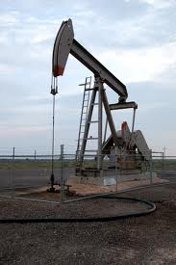
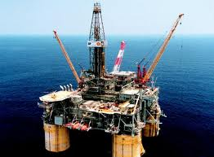
Oil
Petroleum is formed very similar to coal- mostly marine organic material buried in sediment and subjected to high pressure and temperature.
Oil is available in porous sandstone and limestone
Proven reserves used at current consumption rate estimated to last 45 years.
Oil Field

Slide 12
Alternative sources of energy
-that can be used as a replacement for fossil fuel
renewable source of energy
also sustainable source of energy which means people will be able to use them long after fossil fuels have run out.
Advantages
Always available
No carbon emissions
Clean: no local air or water pollution
Locally available
Disadvantages
High cost of research for new technology
Too expensive for poor countries to set up and use
Wind turbines are noisy and can spoil the natural beauty of a place
Weather disturbance

Slide 13
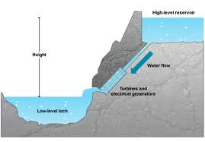
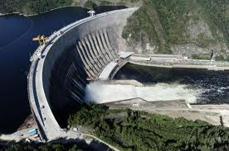
Hydroelectric power:
is in most widespread use
fast running water drives the turbines that work the generators & produce electricity
the greater the force & amount of water, the greater the amount of electricity produced
Hydroelectric Power Station

Slide 14
Certain favorable physical conditions are essential which include
fast flowing water (such as water fall)
High rainfall (preferably spread throughout the year)
Natural store of water such as a lake
Narrow deep valley suitable for building a dam & making a reservoir
Advantage/Benefit:
- one of the cheapest ways of making electricity
natural flow of water allows continuous generation of electricity without any pollution
water is neither consumed nor contaminated, so can be used for other purposes e.g. drinking & irrigation

Slide 15
Problems:
dam is often needed to store water in order to guarantee a year-round supply
large dams are expensive, developing countries may get into debt
forests & other types of natural vegetation may be destroyed as also wildlife habitats
people already living in valley that is going to be flooded are forced to move into new settlements

Slide 16
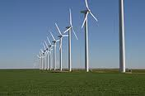
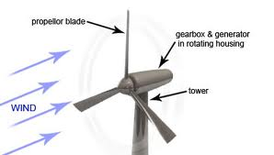
Wind power:
Using tall turbines driven by the force of the wind
are placed where strong winds are most frequent
- on hill tops & other areas of open high ground
- along the coastline ( on land)
- offshore (in the sea) but close to the shore

Slide 17
Advantage :
offers the promise of producing low cost electricity
pollution free
land below turbine can be used for growing crops & grazing
Disadvantage:
back-up systems may become necessary on days without strong winds
noise produced by turbines makes it unsuitable for installation in populated localities

Slide 18
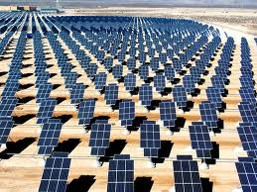
Solar power:
heat from the light of the sun using solar panels & photovoltaic cell (solar cell)
Solar Panel

Slide 19
Advantage:
* Solar power is pollution free and causes no greenhouse gases to be emitted after installation.
* Reduced dependence on foreign oil and fossil fuels.
* Renewable clean power that is available every day of the year, even cloudy days produce some power.
* No monthly payment needed
Disadvantage:
electricity produced by solar cells is not affordable due to high costs of solar cells

Slide 20
SUSTAINABLE ENERGY
Sustainable energy is the provision of energy that meets the needs of the present without compromising the ability of future generations to meet their needs. Sustainable energy sources are most often regarded as including all renewable energy sources, such as solar energy, wind power, wave power, geo thermal power, and tidal power.
Integrated energy management recognize that no single energy source can provide all the energy required by the various countries of the world. A basic goal of integrated energy management is to move toward sustainable energy development.

Slide 21
Characteristics of sustainable energy development
It would provide reliable source of energy
It would not cause destruction or serious harm to our global or local environments
It would help ensure the future generations inherit a quality environment with a fair share of the earth’s resources.

Slide 22
THANK YOU

